Slide 1

BUS TICKETING APPLICATION
Group members with StudentId
Srushti Hate-23107120
Dhiraj Jhadhav-23107131
Shubham Chavan-23107082
Aarya Bhangare-23107104
Project Guide
Ms. Ashwini Rahude

Slide 2
Contents
Introduction
Objectives
Scope
Features / Functionality
Project Outcomes
Technology Stack
Block Diagram if applicable

Slide 3
1. Introduction
Problem Identified: Inefficient manual ticketing system and limited accessibility.
Solution Proposed: Efficient ticketing platform.
Welcome to our Bus Ticketing Application, a user-friendly platform designed to simplify your travel experience. Whether you’re a frequent traveler or planning a one-time journey, our app provides a seamless solution for booking bus tickets. With features such as real-time bus schedules, seat selection, and secure payment options, we aim to make your journey hassle-free from start to finish.

Slide 4
2. Objectives
User Management: Enable user registration and authentication to allow passengers to create and manage their profiles securely.
Ticket Booking System: Implement a seamless booking process that allows users to search for available buses, select seats, and make payments.
Feedback System: Incorporate a feature for users to provide feedback and ratings on their travel experience, helping to improve services.
Simple UI: Simple layout for easy navigation.

Slide 5
3. Scope
Benefit to users: The online bus ticketing system will provide convenience and accessibility to users, eliminating the need for physical ticketing offices.
Improved efficiency: The system will streamline the ticketing process, reducing waiting times and human errors.
Real-time information: Users will have access to accurate and up-to-date bus schedules, allowing them to plan their journeys efficiently.
Enhanced security: The secure payment gateway will protect user financial information and ensure safe transactions.
Accessibility: The mobile app compatibility will make it easy for users to purchase tickets on the go, regardless of their location.

Slide 6
4. Feature /Functionality
List of FAQs will be given for user's convenience.
Simple layout for better understanding.
Tickets will be generated faster.
Offer membership with a discount of 30% on tickets.

Slide 7
5. Outcome of Project
User Login: Users will be able to create accounts and log in to the system.
Search Functionality: Users will be able to search for available bus routes, departure times, and prices.
Ticket Booking: Users will be able to book tickets by providing necessary information such as:
Travel date
Number of passengers
Seating preferences
Payment details
The project may include additional features such as:
Customer support options.

Slide 8
6. Technology Stack
Frontend:Java
Backend:Mysql
Other Tools: Canva (for design)

Slide 9
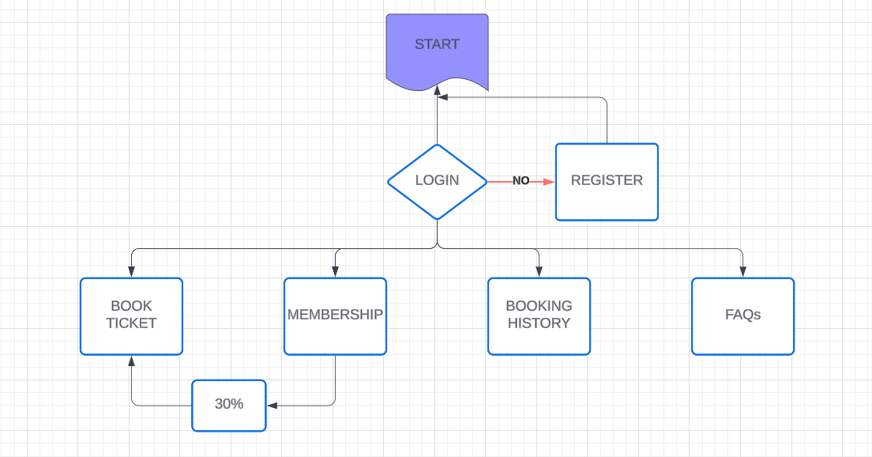
7. Block Diagram

Slide 10
Thank You...!!

